Slide 1

Research Project
LOS Prediction Under Rainy Condition

Slide 2

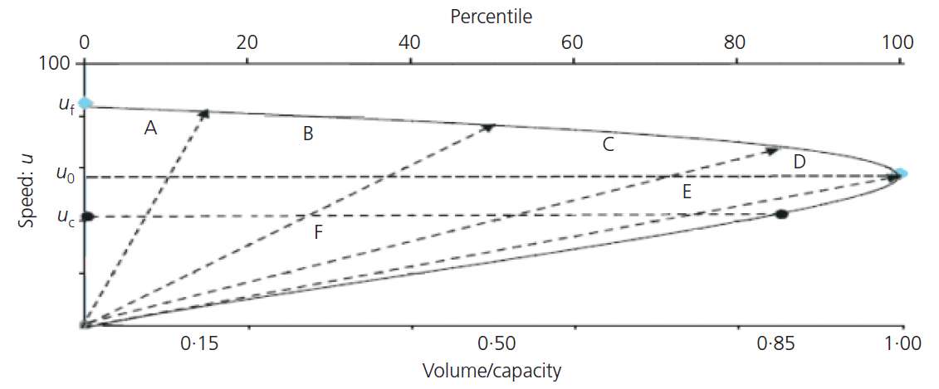
Determining the quality of highway service caused by rainfall 2013

Slide 3
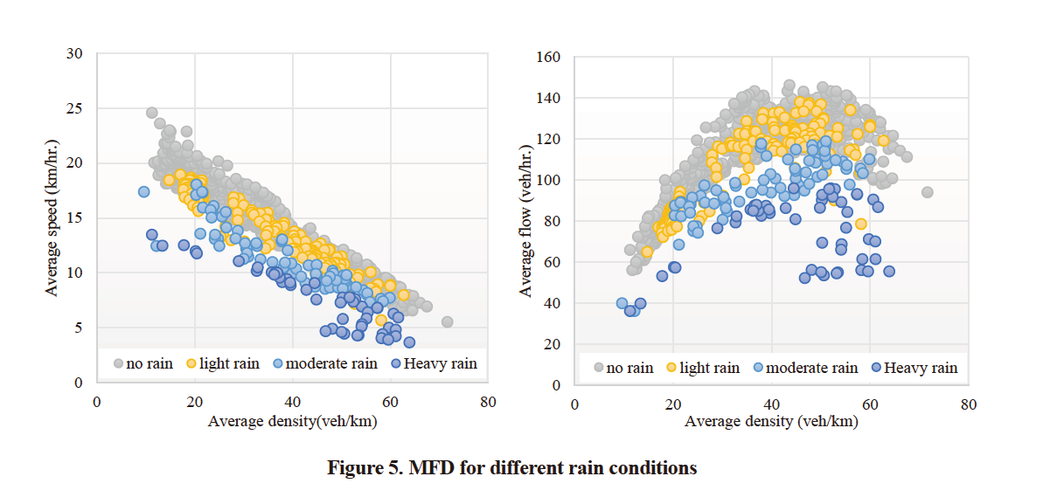
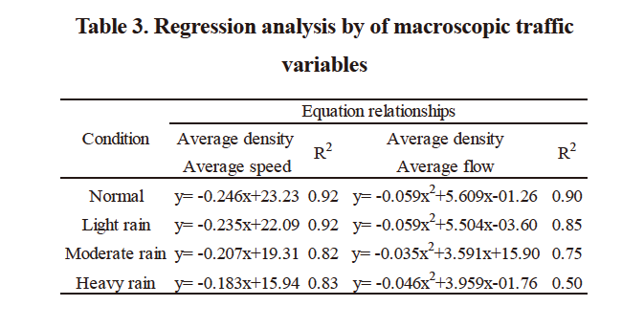
Impact of Rainfall Intensity on Macroscopic Traffic Variables of Urban Roads Using Data from Bluetooth Detectors 2021
Macroscopic Fundamental Diagram (MFD)
Notes:
1

Slide 4
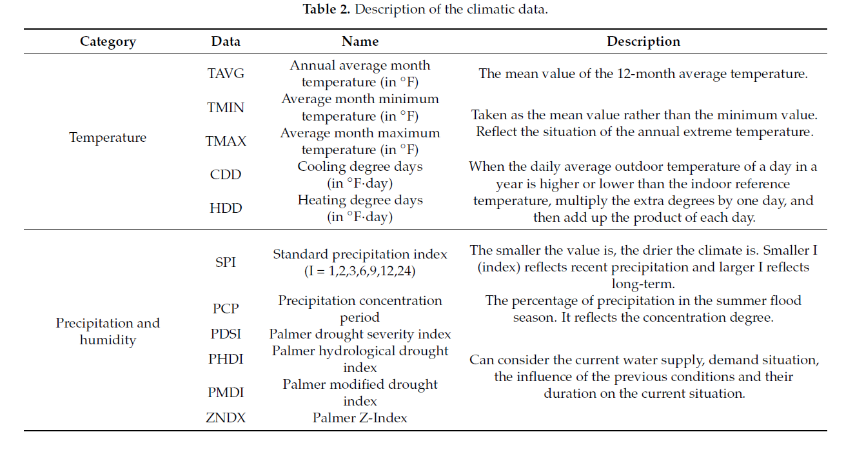
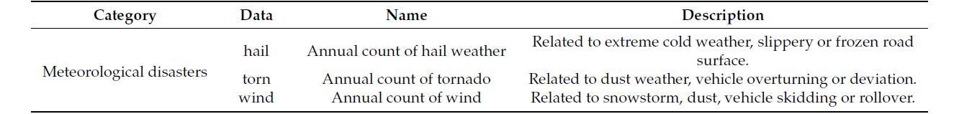
Exploring the Impact of Climate and Extreme Weather on Fatal Traffic Accidents 2021
Notes:
3

Slide 5
Feature Engineering and Traditional Machine Learning
Graph Neural Networks
Transfer Learning
Multimodal Deep Learning
Ensembling and Fusion
Notes:
15
In this approach, you can combine the rainfall data and street data using data fusion techniques. This involves preprocessing the data, extracting relevant features, and then training a deep learning model on the fused data. The model can be designed to take both rainfall and street-related features as inputs and predict the corresponding change in LOS. You can use techniques like convolutional neural networks (CNNs) for processing spatial street data and recurrent neural networks (RNNs) for handling sequential rainfall data.
If you have street data that can be represented as a graph, such as a road network, you can employ Graph Neural Networks (GNNs) for prediction. GNNs are designed to handle graph-structured data and can capture the relationships between different street segments or road nodes. By incorporating rainfall data as node or edge features in the graph representation, you can train a GNN to predict the change in LOS based on the combined information.
Ensembling techniques, such as model averaging or stacking, can be used to combine predictions from multiple models. In this approach, you can train separate deep learning models on rainfall data and street data individually. Then, you can combine the predictions from these models using fusion techniques, such as weighted averaging or majority voting, to obtain the final prediction of the change in LOS. This can help leverage the strengths of each model and enhance prediction accuracy.
If you have additional domain knowledge about the relationship between rainfall and LOS, you can incorporate handcrafted features derived from the rainfall and street data. These features may capture specific characteristics or interactions that are relevant to the problem. Once the features are engineered, you can apply traditional machine learning algorithms, such as random forests or support vector machines, to build a predictive model.

Slide 6
Study | Traffic Data | Weather | Prediction Method | Findings
Assessing the Impact of Rainfall on Traffic Operation of Urban Road Network 2013 | Guangzhou | - | Hyposesis Test and Regression | 4.9% reduction in critical accumulation 9.9% reduction in max flow
Determining the quality of highway service caused by rainfall 2013 | Malayisa | Light: <2.5mm/h Moderate: 2.5-10mm/h Heavy: 10-50mm/h | F-observed T-observed | Capacity loss Speed reduction Shockwave no obvious correlation
Improving Traffic Flow Prediction with Weather Information in Connected Cars A Deep Learning Approach 2016 | PEMS dataset (47 freeways) (http://pems.dot.ca.gov/), 15 min resolution | NOAA, 1 h sampling interval Rainfall data from 16 stations available hourly, resampled to 15 min | ARIMA, ANN and DBN | -

Slide 7
Study | Traffic Data | Weather | Prediction Method | Findings
Impact Analysis of Rainfall on Traffic Flow Characteristics in Beijing 2018 | Beijing | - | Mathematic methods and callibrating | -
Exploring the Spatial-Temporal Relationship between Rainfall and Traffic Flow A Case Study of Brisbane, Australia 2020 | Australia | Temperature Rainfall Wind speed | LR, MLR, OLR | precipitation affects an increase in traffic demand | weather conditions have a greater impact in urban areas compared with suburban areas.
Impact of Rainfall on Traffic Speed in Major Cities of China 2021 | Major Cities of China | - | Ordinary Least Squares (OLS) Regression Analysis | Existenceof relationship

Slide 8
Study | Traffic Data | Weather | Prediction Method | Findings
Analyzing the Effects of Rainfall on Urban traffic congestion Bottlenecks 2020 | China | Stations | ICC | -
Estimating the Impact of High-Fidelity Rainfall Data on Traffic Conditions and Traffic Prediction 2021 | - | high-resolution rainfall radar images of street networks | RNN | -
Exploring the Impact of Climate and Extreme Weather on Fatal Traffic Accidents 2021 | - | - | Negative Binomial model and the log-change model | precipitation increases by 0.5 mm in 24 months, the number of fatal traffic accidents will increase by 4.8% in California and 4.6% in Arizona .
Impact of Rainfall Intensity on Macroscopic Traffic Variables of Urban Roads Using Data from Bluetooth Detectors 2021 | vehicle detectors placed on the main roads of Bangkok | light(0.1-10mm/h) | moderate(10.1-35mm/h) | heavy(over 35mm/h) | Hyposesis Test and Regression | average speed reduction -> 6.7% to 53.3% | average traffic flow rate reduction -> 1% to 27% | increase in travel time -> 4.5% to 128%

